Slide 1
The Price of Anarchy in Auctions
Part II: The Smoothness Framework
Jason Hartline
Northwestern University
Vasilis Syrgkanis
Cornell University
December 11, 2013

Slide 2
Part II: High-level goals
PoA in auctions (as games of incomplete information):
  Single-Item First Price, All-Pay, Second Price Auctions
  Simultaneous Single Item Auctions
  Position Auctions: GSP, GFP
  Combinatorial auctions

Slide 3
General Approach
Reduce analysis of complex setting to simple setting.
Conclusion for simple setting X, proved under restriction P, extends to complex setting Y
  X: complete information PNE to Y: incomplete information BNE
  X: single auction to Y: composition of auctions

Slide 4
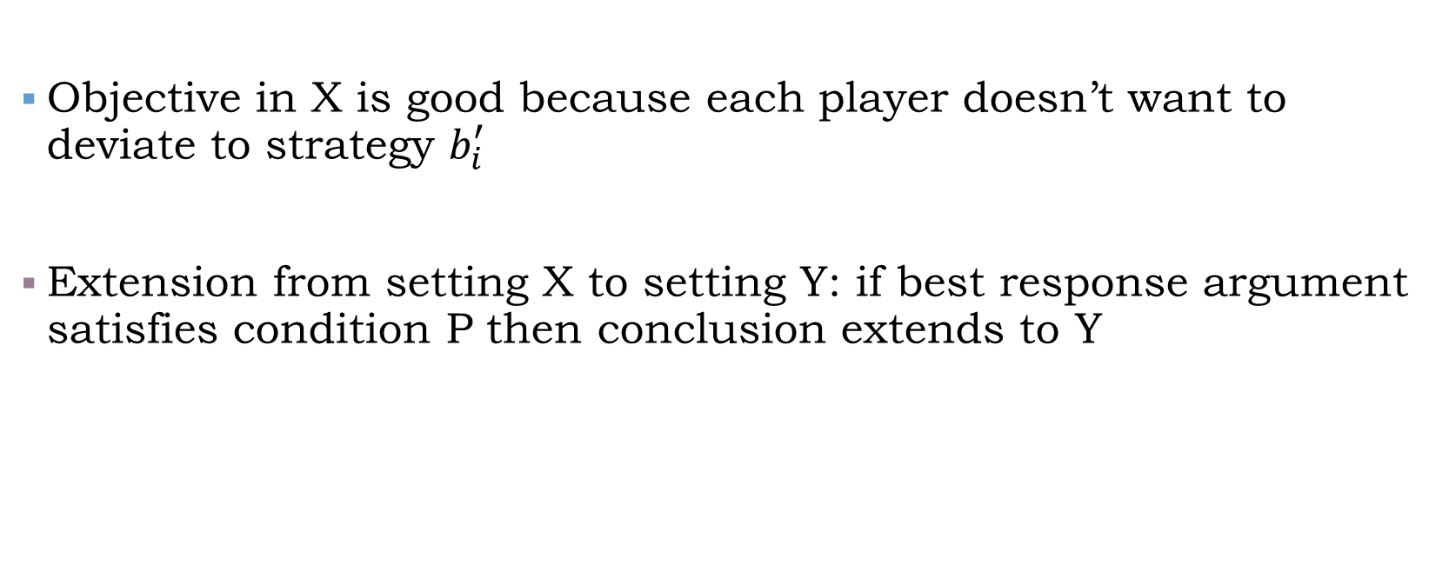
Best-Response Analysis
Objective in X is good because each player doesn’t want to deviate to strategy $b_{i}^{′}$
Extension from setting X to setting Y: if best response argument satisfies condition P then conclusion extends to Y

Slide 5
First Extension Theorem
Complete info PNE to BNE with correlated values

Slide 6
First Extension Theorem
Target setting. First Price Bayes-Nash Equilibrium with asymmetric correlated values
Simple setting. Complete information Pure Nash Equilibrium
Thm. If proof of PNE PoA based on own-value based deviation argument then PoA of BNE also good
Complete info PNE to BNE with correlated values
References:
Roughgarden STOC’09
Lucier, Paes Leme EC’11
Roughgarden EC’12
Syrgkanis ‘12
Syrgkanis, Tardos STOC’13

Slide 7






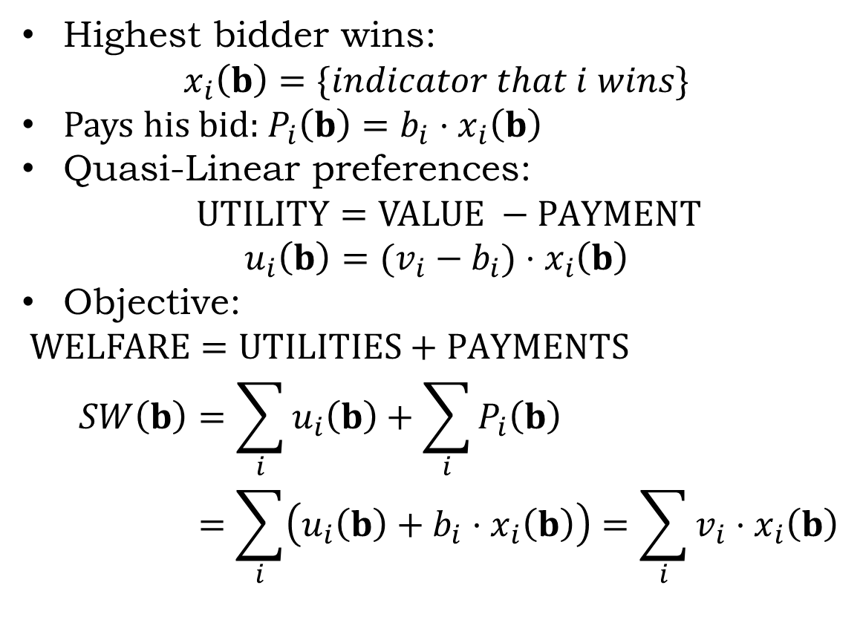


First-Price Auction Refresher
Highest bidder wins:
$$x_{i}\left(b\right)=\{indicator that i wins\}$$
Pays his bid: $P_{i}\left(b\right)=b_{i}⋅x_{i}\left(b\right)$
Quasi-Linear preferences:
$$UTILITY=VALUE −PAYMENT$$
$$u_{i}\left(b\right)=(v_{i}−b_{i})⋅x_{i}\left(b\right)$$
Objective:
$$WELFARE=UTILITIES+PAYMENTS$$
$$SW\left(b\right)=\sum_{i}{u_{i}\left(b\right)}+\sum_{i}{P_{i}\left(b\right)}$$
$$=\sum_{i}{\left(u_{i}\left(b\right)+b_{i}⋅x_{i}\left(b\right)\right)}=\sum_{i}{v_{i}⋅x_{i}\left(b\right)}$$
$$v_{1}$$
$$b_{1}$$
$$v_{i}$$
$$b_{i}$$
$$v_{n}$$
$$b_{n}$$

Slide 8



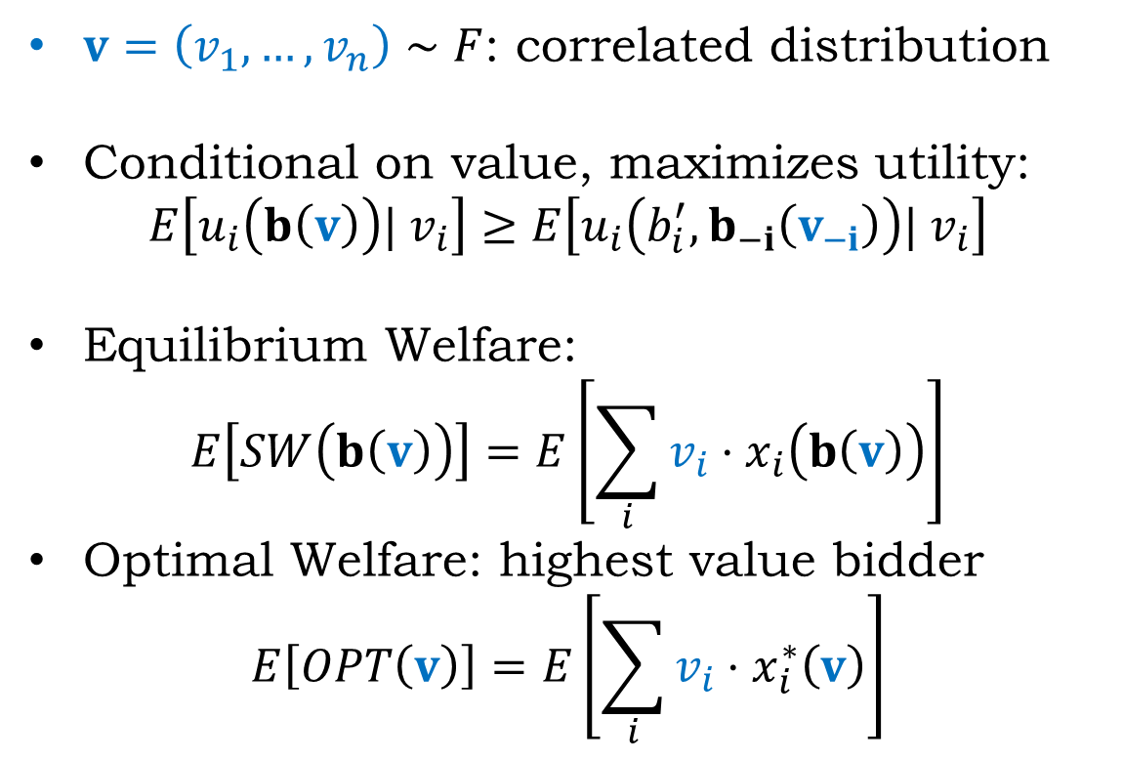

First-Price Auction
Target: BNE with correlated values
$$v_{1}$$
$v=\left(v_{1},…,v_{n}\right)∼F$: correlated distribution
Conditional on value, maximizes utility:
$$E\left[u_{i}\left(b\left(v\right)\right)| v_{i}\right]≥E\left[u_{i}\left(b_{i}^{′},b_{−i}\left(v_{−i}\right)\right)| v_{i}\right]$$
Equilibrium Welfare:
$$E\left[SW\left(b\left(v\right)\right)\right]=E\left[\sum_{i}{v_{i}⋅x_{i}\left(b\left(v\right)\right)}\right]$$
Optimal Welfare: highest value bidder
$$E\left[OPT\left(v\right)\right]=E\left[\sum_{i}{v_{i}⋅x_{i}^{∗}\left(v\right)}\right]$$
$$b_{1}\left(v_{1}\right)$$
$$v_{i}$$
$$F∼$$
$$b_{i}\left(v_{i}\right)$$
$$v_{n}$$
$$b_{n}\left(v_{n}\right)$$

Slide 9

First-Price Auction
Target: BNE with correlated values
$$v_{1}$$
$$b_{1}\left(v_{1}\right)$$
$$v_{i}$$
$$F∼$$
$$PoA=\frac{E\left[OPT\left(v\right)\right]}{E\left[SW\left(b\left(v\right)\right)\right]}$$
$$b_{i}\left(v_{i}\right)$$
$$v_{n}$$
$$b_{n}\left(v_{n}\right)$$

Slide 10

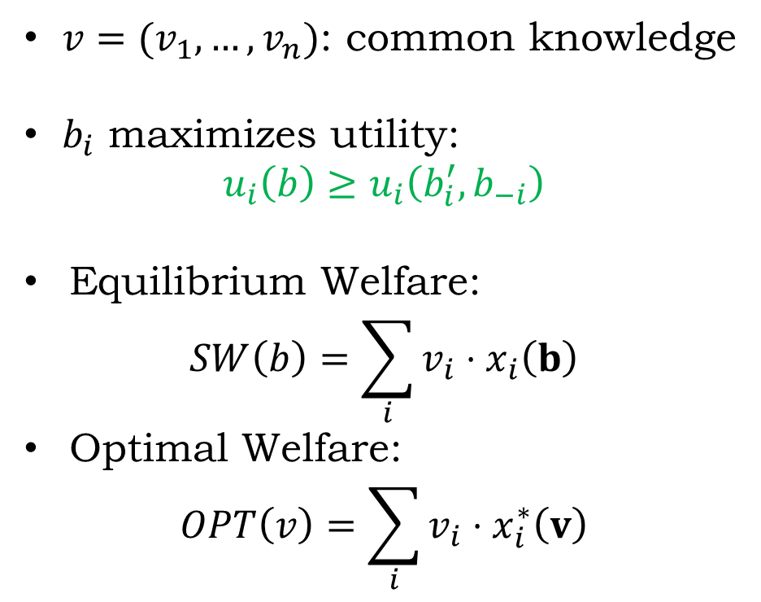
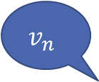

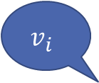

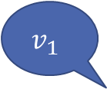


First-Price Auction
Simpler: PNE and complete Information
$$v_{1}$$
$v=(v_{1},…, v_{n})$: common knowledge
$b_{i}$ maximizes utility:
$$u_{i}\left(b\right)≥u_{i}\left(b_{i}^{′},b_{−i}\right)$$
Equilibrium Welfare:
$$SW\left(b\right)=\sum_{i}{v_{i}⋅x_{i}\left(b\right)}$$
Optimal Welfare:
$$OPT\left(v\right)=\sum_{i}{v_{i}⋅x_{i}^{∗}\left(v\right)}$$
$$≥$$
$$b_{1}$$
$$v_{i}$$
$$b_{i}$$
$$≥$$
$$v_{n}$$
$$b_{n}$$

Slide 11










First-Price Auction
Simpler: PNE and complete Information
$$v_{1}$$
$$≥$$
$$b_{1}$$
$$v_{i}$$
$$PoA=\frac{OPT(v) }{SW(b)}$$
$$b_{i}$$
$$≥$$
$$v_{n}$$
$$p\left(b\right)=\max_{i}{b_{i}}$$
$$b_{n}$$

Slide 12

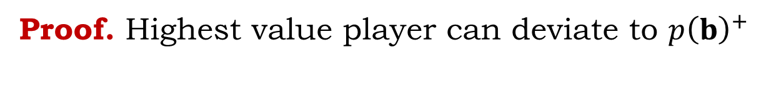



First-Price Auction
Simpler: PNE and complete Information
$$v_{1}$$
Theorem. $PoA=1$
$$≥$$
$$b_{1}$$
Proof. Highest value player can deviate to $p{\left(b\right)}^{+}$
$$v_{i}$$
$$u_{1}\left(p{\left(b\right)}^{+},b_{−i}\right)=v_{1}−p{\left(b\right)}^{+}$$
$$u_{i}\left(0,b_{−i}\right)=0$$
$$b_{i}$$
$$≥$$
$$\sum_{i}{u_{i}\left(b_{i}^{′},b_{−i }\right)=}v_{1}−p\left(b\right)$$
$$\sum_{i}{u_{i}\left(b\right)}≥$$
$$v_{n}$$
$$p\left(b\right)=\max_{i}{b_{i}}$$
$$b_{n}$$
By PNE condition

Slide 13



First-Price Auction
Simpler: PNE and complete Information
$$v_{1}$$
Theorem. $PoA=1$
$$≥$$
$$b_{1}$$
Proof. Highest value player can deviate to $p{\left(b\right)}^{+}$
$$v_{i}$$
$$u_{1}\left(p{\left(b\right)}^{+},b_{−i}\right)=v_{1}−p{\left(b\right)}^{+}$$
$$u_{i}\left(0,b_{−i}\right)=0$$
$$b_{i}$$
$$≥$$
$$\sum_{i}{u_{i}\left(b_{i}^{′},b_{−i }\right)=}v_{1}−REV(b)$$
$$v_{n}$$
$$p\left(b\right)=\max_{i}{b_{i}}$$
$$UTIL(b)≥$$
$$b_{n}$$
$$UTIL\left(b\right)+REV\left(b\right)≥v_{1}$$
$$SW(b)≥v_{1}$$

Slide 14
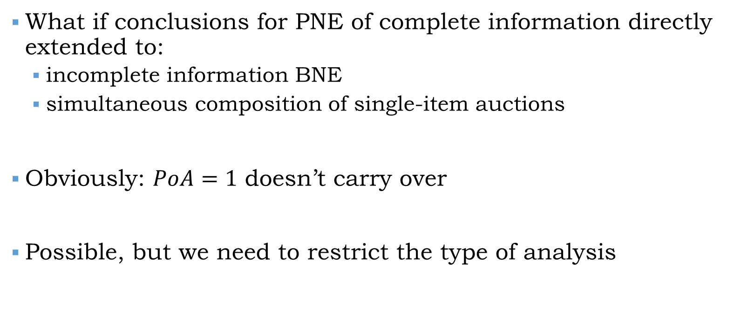
Direct extensions
What if conclusions for PNE of complete information directly extended to:
  incomplete information BNE
  simultaneous composition of single-item auctions
Obviously: $PoA=1$ doesn’t carry over
Possible, but we need to restrict the type of analysis

Slide 15


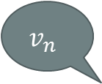
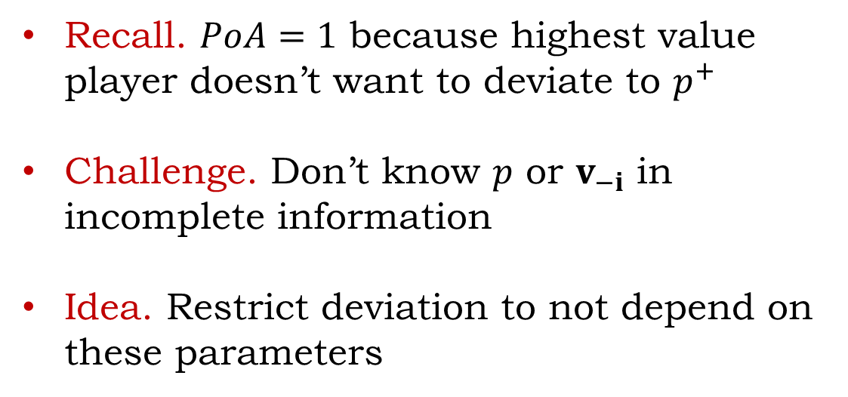
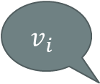




Problem in previous PNE proof
$$v_{1}$$
Recall. $PoA=1$ because highest value player doesn’t want to deviate to $p^{+}$
Challenge. Don’t know $p$ or $v_{−i}$ in incomplete information
Idea. Restrict deviation to not depend on these parameters
$$≥$$
$$v_{i}$$
$$b_{1}^{′}$$
$$p^{+}$$
$$≥$$
$$v_{n}$$
$$p=\max_{i}{b_{i}}$$

Slide 16


First-Price Auction
Simpler: PNE and complete Information
Recall PoA=1 Proof
$$v_{1}$$
Theorem. $PoA=1$
$$≥$$
$$b_{1}$$
Proof. Highest value player can deviate to $p{\left(b\right)}^{+}$
$$v_{i}$$
$$u_{1}\left(p{\left(b\right)}^{+},b_{−i}\right)=v_{1}−p{\left(b\right)}^{+}$$
$$u_{i}\left(0,b_{−i}\right)=0$$
Can we find $b_{i}^{′}$ that depend only on $v_{i}$?
$$b_{i}$$
$$≥$$
$$\sum_{i}{u_{i}\left(b_{i}^{′},b_{−i }\right)=}v_{1}−REV(b)$$
$$v_{n}$$
$$p\left(b\right)=\max_{i}{b_{i}}$$
$$U(b)≥$$
$$b_{n}$$
$$U\left(b\right)+REV\left(b\right)≥v_{1}$$
$$SW(b)≥v_{1}$$

Slide 17
















Own-value deviations
(price and other values oblivious)
$$v_{1}$$
New Theorem. $PoA≤2$
$$≥$$
$$b_{1}$$
Proof. Each player can deviate to $b_{i}^{′}=\frac{v_{i}}{2}$
$$v_{i}$$
$$x(b_{i},b_{−i})$$
$$x(b_{i},b_{−i})$$
$$1$$
$$1$$
$$b_{i}$$
$$\frac{v_{i}}{2}$$
$$p\left(b\right)≥\frac{v_{i}}{2}$$
$$≥$$
$$v_{n}$$
$$p\left(b\right)=\max_{i}{b_{i}}$$
OR
$$b_{n}$$
$$\frac{v_{i}}{2}$$
$$b_{i}$$
$$\frac{v_{i}}{2}$$
$$p\left(b\right)$$
$$v_{i}$$
$$b_{i}$$
$$p\left(b\right)$$
$$v_{i}$$

Slide 18




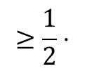




Own-value deviations
(price and other values oblivious)
$$v_{1}$$
New Theorem. $PoA≤2$
$$≥$$
$$b_{1}$$
Proof. Each player can deviate to $b_{i}^{′}=\frac{v_{i}}{2}$
$$v_{i}$$
$$x(b_{i},b_{−i})$$
$$x(b_{i},b_{−i})$$
$$1$$
$$b_{i}$$
$$p\left(b\right)$$
$$u_{i}\left(b_{i}^{′},b_{−i}\right)$$
$$v_{i}$$
$$≥$$
$$v_{n}$$
$$p\left(b\right)=\max_{i}{b_{i}}$$
$$≥\frac{1}{2}⋅$$
$$≥$$
$$b_{n}$$
$$\frac{v_{i}}{2}$$
$$b_{i}$$
$$b_{i}$$
$$p\left(b\right)$$
$$v_{i}$$
$$p\left(b\right)$$
$$v_{i}$$

Slide 19
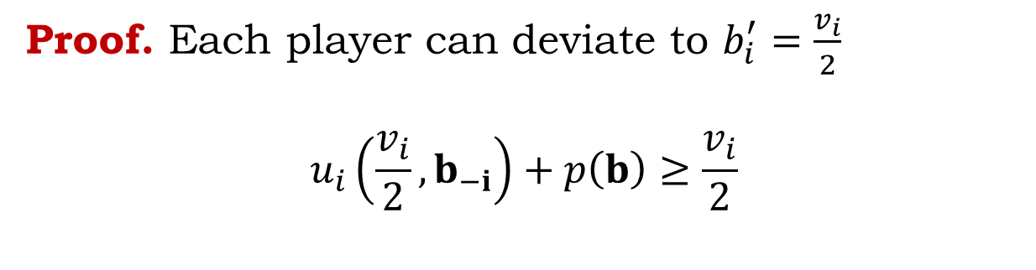
Own-value deviations
(price and other values oblivious)
$$v_{1}$$
New Theorem. $PoA≤2$
$$≥$$
$$b_{1}$$
Proof. Each player can deviate to $b_{i}^{′}=\frac{v_{i}}{2}$
$$u_{i}\left(\frac{v_{i}}{2},b_{−i}\right)+p\left(b\right)≥\frac{v_{i}}{2}$$
$$v_{i}$$
$$b_{i}$$
$$≥$$
$$v_{n}$$
$$p\left(b\right)=\max_{i}{b_{i}}$$
$$b_{n}$$

Slide 20

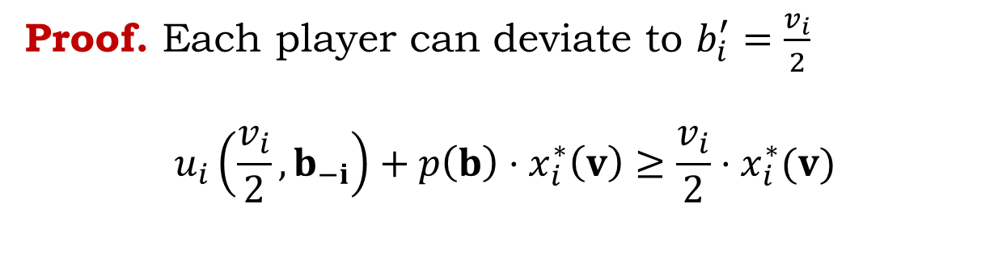


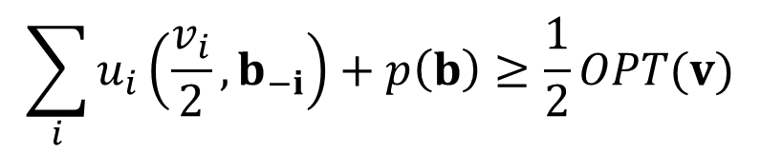
Own-value deviations
(price and other values oblivious)
$$v_{1}$$
New Theorem. $PoA≤2$
$$≥$$
$$b_{1}$$
Proof. Each player can deviate to $b_{i}^{′}=\frac{v_{i}}{2}$
$$u_{i}\left(\frac{v_{i}}{2},b_{−i}\right)+p\left(b\right)⋅x_{i}^{∗}\left(v\right)≥\frac{v_{i}}{2}⋅x_{i}^{∗}(v)$$
$$v_{i}$$
$$b_{i}$$
$$≥$$
$$\sum_{i}{u_{i}\left(\frac{v_{i}}{2},b_{−i}\right)}+p\left(b\right)≥\frac{1}{2}OPT(v)$$
$$p\left(b\right)=\max_{i}{b_{i}}$$
$$UTIL(b)≥$$
$$v_{n}$$
$$UTIL\left(b\right)+REV\left(b\right)≥\frac{1}{2}OPT(v)$$
$$b_{n}$$
$$SW(b)≥\frac{1}{2}OPT(v)$$

Slide 21

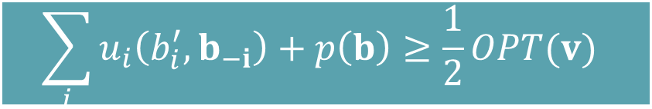


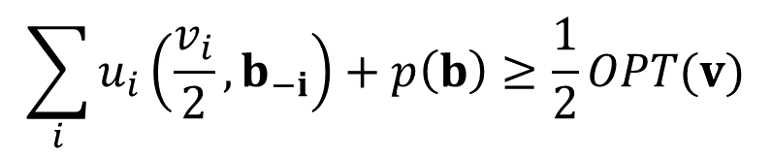
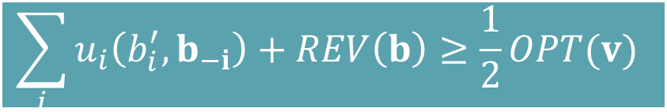
Own-value deviations
(price and other values oblivious)
Key Deviation Property
Smoothness Property
$$v_{1}$$
New Theorem. $PoA≤2$
Exists $b_{i}^{′}$ depending only on own value
$$≥$$
$$b_{1}$$
Proof. Each player can deviate to $b_{i}^{′}=\frac{v_{i}}{2}$
$$u_{i}\left(\frac{v_{i}}{2},b_{−i}\right)+p\left(b\right)⋅x_{i}^{∗}\left(v\right)≥\frac{v_{i}}{2}⋅x_{i}^{∗}(v)$$
$$v_{i}$$
$$b_{i}$$
$$≥$$
$$\sum_{i}{u_{i}\left(\frac{v_{i}}{2},b_{−i}\right)}+p\left(b\right)≥\frac{1}{2}OPT(v)$$
$$\sum_{i}{u_{i}\left(b_{i}^{′},b_{−i}\right)}+REV\left(b\right)≥\frac{1}{2}OPT(v)$$
$$UTIL(b)≥$$
$$\sum_{i}{u_{i}\left(b_{i}^{′},b_{−i}\right)}+p\left(b\right)≥\frac{1}{2}OPT(v)$$
$$v_{n}$$
$$p\left(b\right)=\max_{i}{b_{i}}$$
$$UTIL\left(b\right)+REV\left(b\right)≥\frac{1}{2}OPT(v)$$
$$b_{n}$$
$$SW(b)≥\frac{1}{2}OPT(v)$$

Slide 22
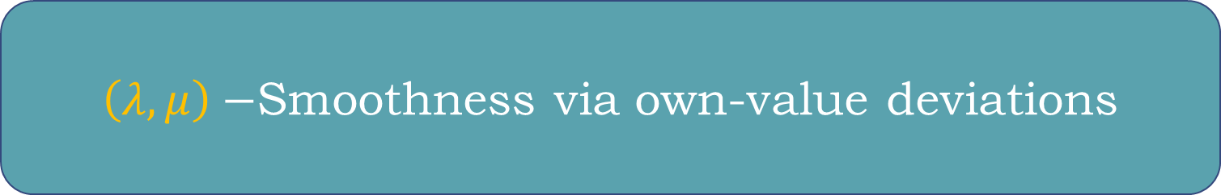
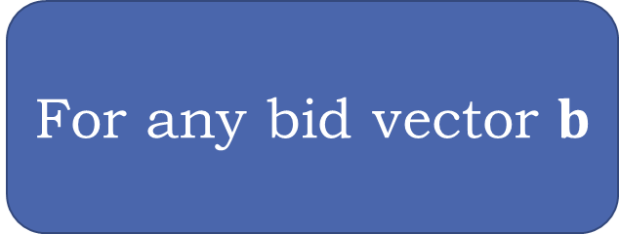
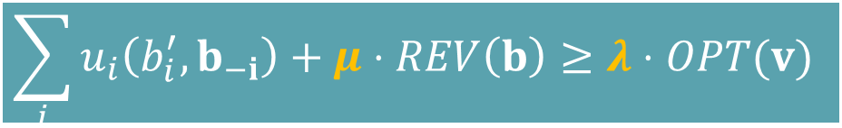
$\left(λ,μ\right)−$Smoothness via own-value deviations
Exists $b_{i}^{′}$ depending only on own value
For any bid vector $b$
$$\sum_{i}{u_{i}\left(b_{i}^{′},b_{−i}\right)}+μ⋅REV\left(b\right)≥λ⋅OPT(v)$$

Slide 23
$\left(λ,μ\right)−$Smoothness via own-value deviations
Exists $b_{i}^{′}$ depending only on own value
For any bid vector $b$
$$\sum_{i}{u_{i}\left(b_{i}^{′},b_{−i}\right)}+μ⋅REV\left(b\right)≥λ⋅OPT(v)$$
Note. Smoothness is property of auction not equilibrium

Slide 24
$\left(λ,μ\right)−$Smoothness via own-value deviations
Exists $b_{i}^{′}$ depending only on own value
For any bid vector $b$
$$\sum_{i}{u_{i}\left(b_{i}^{′},b_{−i}\right)}+μ⋅REV\left(b\right)≥λ⋅OPT(v)$$
Applies to any auction: Not First-Price Auction specific

Slide 25
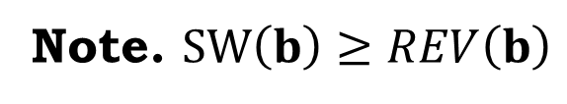
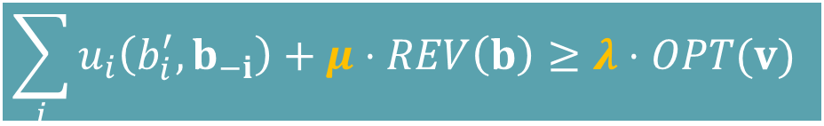
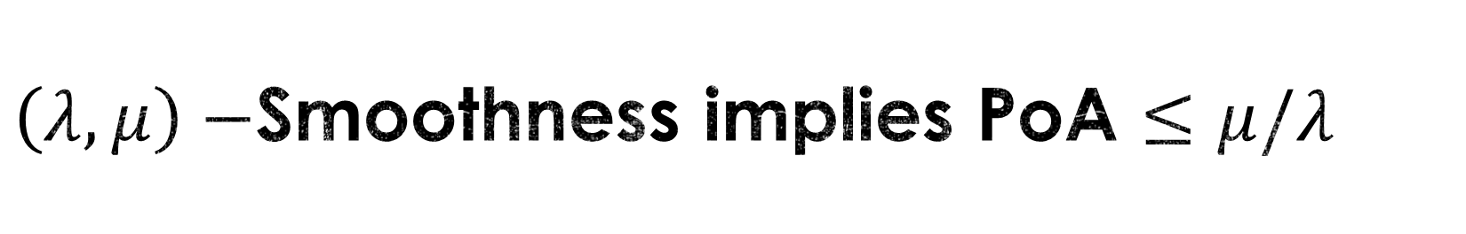

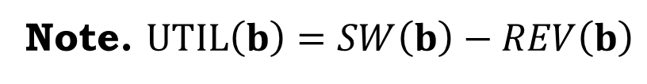


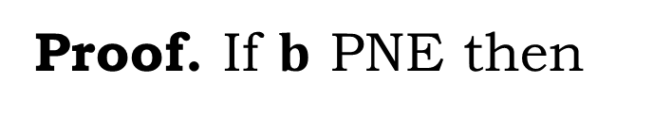

$\left(λ,μ\right)−$Smoothness implies PoA $≤μ/λ$
Proof. If $b$ PNE then
$$\sum_{i}{u_{i}\left(b_{i}^{′},b_{−i}\right)}+μ⋅REV\left(b\right)≥λ⋅OPT(v)$$
$$UTIL\left(b\right)+μ⋅REV(b)≥$$
Note. $UTIL\left(b\right)=SW\left(b\right)−REV\left(b\right)$
$$UTIL\left(b\right)+μ⋅REV\left(b\right)≥λ⋅OPT\left(v\right)$$
Note. $SW\left(b\right)≥REV\left(b\right)$
$$SW\left(b\right)+(μ−1)⋅REV\left(b\right)≥λ⋅OPT\left(v\right)$$
$$SW\left(b\right)+(μ−1)⋅SW\left(b\right)≥λ⋅OPT\left(v\right)$$
$$μ⋅SW\left(b\right)≥λ⋅OPT\left(v\right)$$

Slide 26
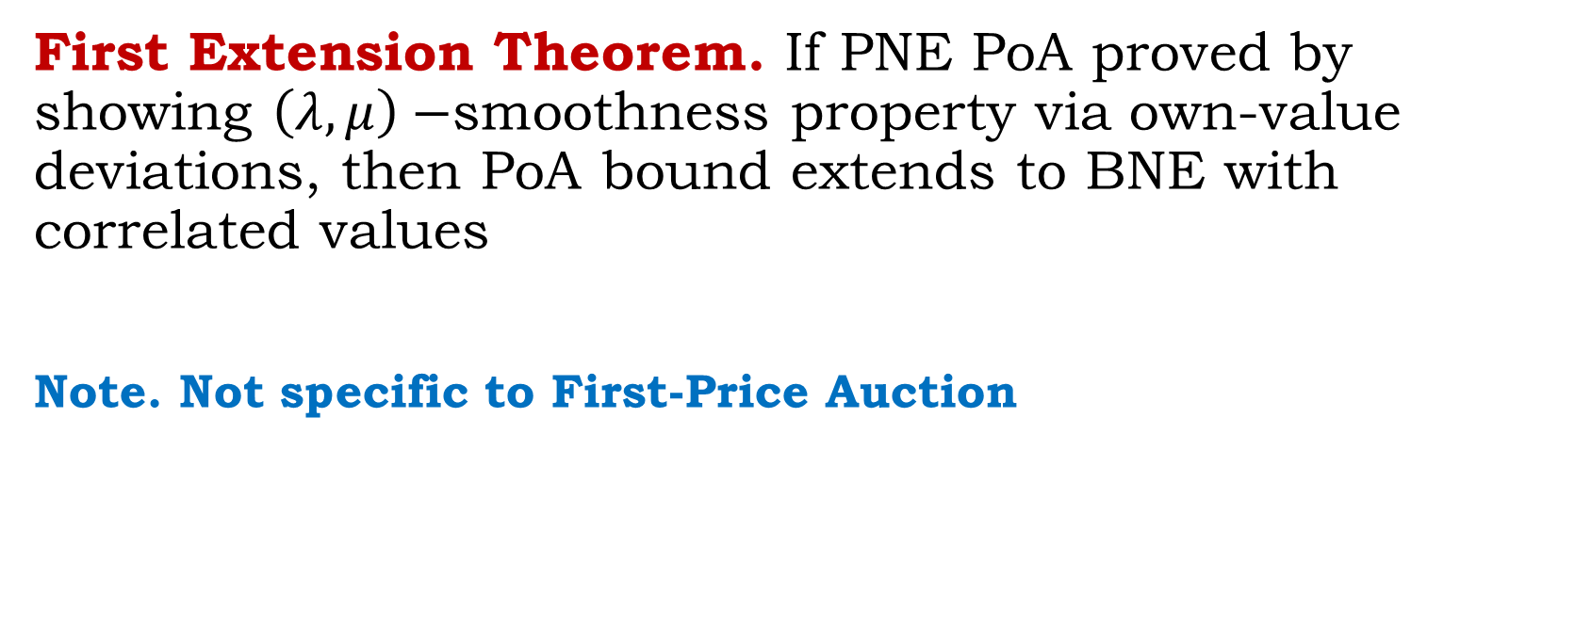
Finally
First Extension Theorem. If PNE PoA proved by showing $\left(λ,μ\right)−$smoothness property via own-value deviations, then PoA bound extends to BNE with correlated values
Note. Not specific to First-Price Auction

Slide 27
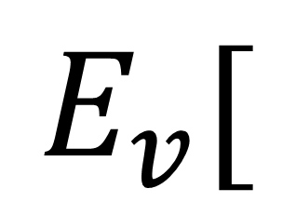
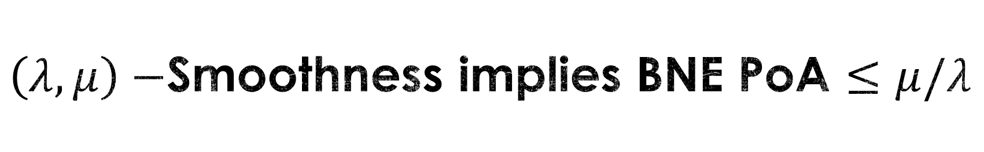
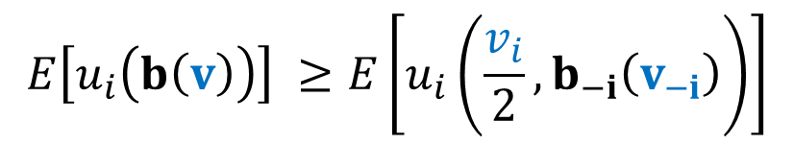

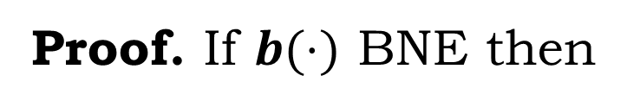
$\left(λ,μ\right)−$Smoothness implies BNE PoA $≤μ/λ$
$$E\left[u_{i}\left(b\left(v\right)\right)\right] ≥E\left[u_{i}\left(\frac{v_{i}}{2},b_{−i}\left(v_{−i}\right)\right)\right]$$
Proof. If $b(⋅)$ BNE then
$$E_{v}[$$
]
$$\sum_{i}{u_{i}\left(b_{i}^{′},b_{−i}\right)}+μ⋅REV\left(b\right)≥λ⋅OPT(v)$$
$$UTIL\left(b\right)+μ⋅REV(b)≥$$
Just redo PNE proof in expectation over values.

Slide 28
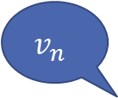





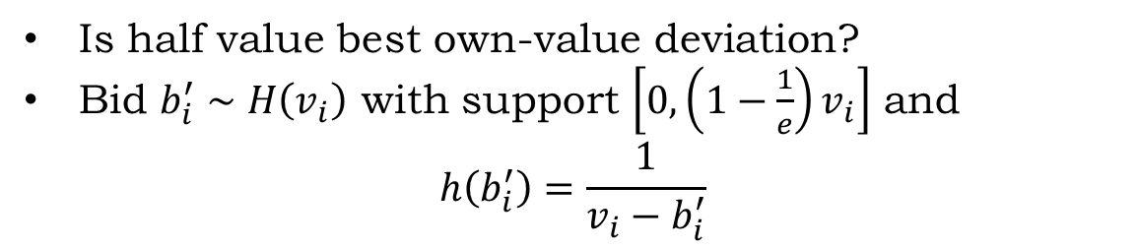


Optimizing over $(λ,μ)$
$$v_{1}$$
Is half value best own-value deviation?
Bid $b_{i}^{′}∼H\left(v_{i}\right)$ with support $\left[0,\left(1−\frac{1}{e}\right)v_{i}\right]$ and
$$h\left(b_{i}^{′}\right)=\frac{1}{v_{i}−b_{i}^{′}}$$
$$b_{1}^{′}∼H\left(v_{1}\right)$$
$$v_{i}$$
$$b_{i}^{′}∼H\left(v_{i}\right)$$
$$v_{n}$$
$$p(b)=\max_{i}{b_{i}}$$
$$b_{n}^{′}∼H\left(v_{n}\right)$$

Slide 29






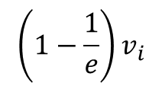

Optimizing over $(λ,μ)$
Bid $b_{i}^{′}∼H\left(v_{i}\right)$ with support $\left[0,\left(1−\frac{1}{e}\right)v_{i}\right]$ and $h\left(b_{i}^{′}\right)=\frac{1}{v_{i}−b_{i}^{′}}$
$$v_{1}$$
$$x(b_{i},b_{−i})$$
$$b_{1}^{′}∼H\left(v_{1}\right)$$
$$u_{i}(b_{i}^{′})$$
$$v_{i}$$
$$b_{i}^{′}∼H\left(v_{i}\right)$$
$$v_{n}$$
$$p(b)=\max_{i}{b_{i}}$$
$$b_{i}$$
$$p\left(b\right)$$
$$b_{i}^{′}$$
$${\left(1−\frac{1}{e}\right)v}_{i}$$
$$v_{i}$$
$$b_{n}^{′}∼H\left(v_{n}\right)$$
w.p. $\frac{1}{v_{i}−b_{i}^{′}}$

Slide 30
Optimizing over $(λ,μ)$
Bid $b_{i}^{′}∼H\left(v_{i}\right)$ with support $\left[0,\left(1−\frac{1}{e}\right)v_{i}\right]$ and $h\left(b_{i}^{′}\right)=\frac{1}{v_{i}−b_{i}^{′}}$
$$v_{1}$$
$$x(b_{i},b_{−i})$$
$$b_{1}^{′}∼H\left(v_{1}\right)$$
$$v_{i}$$
$$b_{i}^{′}∼H\left(v_{i}\right)$$
$$v_{n}$$
$$p(b)=\max_{i}{b_{i}}$$
$$b_{i}$$
$$p\left(b\right)$$
$$b_{i}^{′}$$
$${\left(1−\frac{1}{e}\right)v}_{i}$$
$$v_{i}$$
$$b_{n}^{′}∼H\left(v_{n}\right)$$
w.p. $\frac{1}{v_{i}−b_{i}^{′}}$

Slide 31

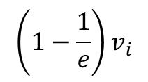


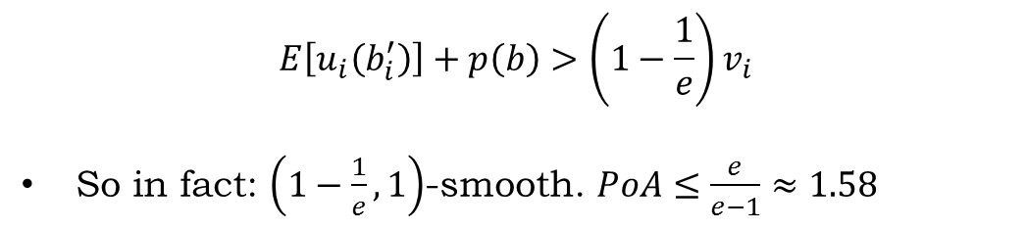



Optimizing over $(λ,μ)$
Bid $b_{i}^{′}∼H\left(v_{i}\right)$ with support $\left[0,\left(1−\frac{1}{e}\right)v_{i}\right]$ and $h\left(b_{i}^{′}\right)=\frac{1}{v_{i}−b_{i}^{′}}$
$$v_{1}$$
$$x(b_{i},b_{−i})$$
$$p\left(b\right)$$
$$E\left[u_{i}\left(b_{i}^{′}\right)\right]$$
$$b_{1}^{′}∼H\left(v_{1}\right)$$
$$v_{i}$$
$$b_{i}^{′}∼H\left(v_{i}\right)$$
$$b_{i}$$
$$p\left(b\right)$$
$${\left(1−\frac{1}{e}\right)v}_{i}$$
$$v_{i}$$
$$v_{n}$$
$$p(b)=\max_{i}{b_{i}}$$
$$b_{n}^{′}∼H\left(v_{n}\right)$$
$$E\left[u_{i}\left(b_{i}^{′}\right)\right]+p\left(b\right)>\left(1−\frac{1}{e}\right)v_{i}$$
So in fact: $\left(1−\frac{1}{e},1\right)$-smooth. $PoA≤\frac{e}{e−1}≈1.58$

Slide 32
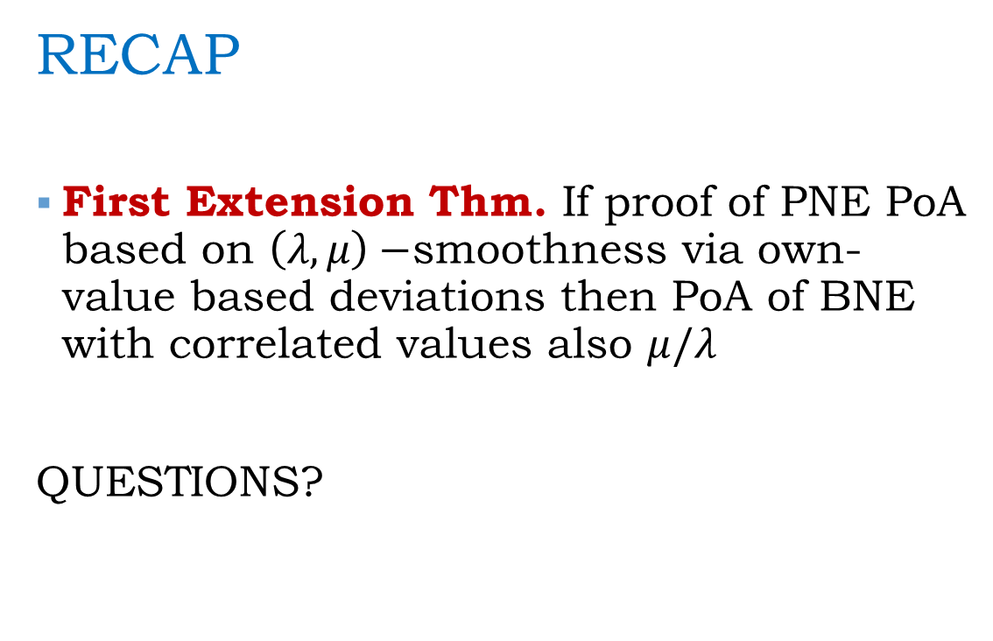
First Extension Theorem
RECAP
First Extension Thm. If proof of PNE PoA based on $\left(λ,μ\right)−$smoothness via own-value based deviations then PoA of BNE with correlated values also $μ/λ$
QUESTIONS?
Complete info PNE to BNE with correlated values

Slide 33
Second Extension Theorem
Single auction to simultaneous auctions
PNE complete information

Slide 34
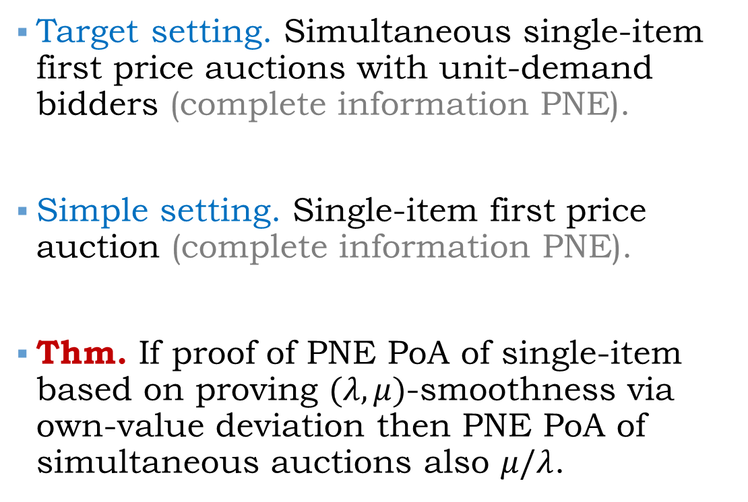
Second Extension Theorem
Target setting. Simultaneous single-item first price auctions with unit-demand bidders (complete information PNE).
Simple setting. Single-item first price auction (complete information PNE).
Thm. If proof of PNE PoA of single-item based on proving $(λ,μ)$-smoothness via own-value deviation then PNE PoA of simultaneous auctions also $μ/λ$.
Single auction to simultaneous auctions
PNE complete information
References:
Roughgarden STOC’09
Roughgarden EC’12
Syrgkanis ‘12
Syrgkanis, Tardos STOC’13

Slide 35










Simultaneous First-Price Auctions
Unit-demand bidders
$$1$$
$$v_{i}^{1}$$
$$v_{i}^{2}$$
$$i$$
Unit-Demand Valuation
$$v_{i}\left(S\right)=\max_{j∈S}{ v}_{i}^{j}$$
$$v_{i}^{3}$$
$$n$$

Slide 36



Simultaneous First-Price Auctions
Unit-demand bidders
$$1$$
$$b_{i}^{1}$$
$$b_{i}^{2}$$
$$i$$
Unit-Demand Valuation
$$v_{i}\left(S\right)=\max_{j∈S}{ v}_{i}^{j}$$
$$b_{i}^{3}$$
$$n$$

Slide 37







Simultaneous First-Price Auctions
Can we derive global efficiency guarantees from local $\left(\frac{1}{2},1\right)−$smoothness of each first price auction?
$$j_{i}^{∗}$$
APPROACH: Prove smoothness of the global mechanism
GOAL: Construct global deviation
IDEA: Pick your item in the optimal allocation and perform the smoothness deviation for your local value $v_{i}^{j}$, i.e. $\frac{v_{i}^{j}}{2}$
$$p_{1}$$
$$\frac{v_{i}^{j}}{2}$$
$$0$$
$$0$$

Slide 38


Simultaneous First-Price Auctions
Smoothness locally:
$$u_{i}\left(b_{i}^{′},b_{−i}\right)+p_{j_{i}^{∗}}\left(b\right)≥\frac{v_{i}^{j_{i}^{∗}}}{2}$$
Summing over players:
$$\sum_{i}{u_{i}\left(b_{i}^{′},b_{−i}\right)}+REV(b)≥\frac{1}{2}OPT(v)$$
Implying $\left(\frac{1}{2},1\right)−$smoothness property globally.
$$\sum_{i}{u_{i}\left(b_{i}^{′},b_{−i}\right)}+REV\left(b\right)≥\frac{1}{2}⋅OPT(v)$$

Slide 39

Second Extension Theorem. If proof of PNE PoA of single-item auction based on proving $(λ,μ)$-smoothness smoothness via own-value deviation then PNE PoA of simultaneous auctions also $≤μ/λ$.

Slide 40

BNE PoA?
BNE PoA of simultaneous single-item auctions with correlated unit-demand values $≤1/2$?
Not really: deviation not oblivious to opponent valuations
Item in the optimal matching depends on values of opponents

Slide 41



But Half-way there
What we showed:
Exists $b_{i}^{′}$ depending only on valuation profile $v$
(not $b_{−i}$)
For any bid vector $b$
$$\sum_{i}{u_{i}\left(b_{i}^{′},b_{−i}\right)}+μ⋅REV\left(b\right)≥λ⋅OPT(v)$$

Slide 42

Second Extension Theorem
RECAP
Second Extension Theorem. If proof of PNE PoA of single-item auction based on proving $(λ,μ)$-smoothness then PNE PoA of simultaneous auctions also $≤μ/λ$.
Next we will extend above to BNE
QUESTIONS?
Single auction to simultaneous auctions
PNE complete information

Slide 43
Third Extension Theorem
Complete info PNE to BNE with independent values

Slide 44

Third Extension Theorem
Target setting. First Price Bayes-Nash Equilibrium with asymmetric independent values
Simple setting. Complete information Pure Nash Equilibrium
Thm. If proof of PNE PoA based on $(λ,μ)$-smoothness via valuation profile dependent deviation then PoA of BNE with independent values also $μ/λ$
Complete info PNE to BNE with independent values
References:
Christodoulou et al. ICALP’08
Roughgarden EC’12
Syrgkanis ‘12
Syrgkanis, Tardos STOC’13

Slide 45

Does this extend to BNE PoA?
$\left(λ,μ\right)−$Smoothness via valuation profile deviations
Exists $b_{i}^{′}$ depending only on valuation profile $v$
(not $b_{−i}$)
For any bid vector $b$
$$\sum_{i}{u_{i}\left(b_{i}^{′},b_{−i}\right)}+μ⋅REV\left(b\right)≥λ⋅OPT(v)$$

Slide 46

Recall First Extension Theorem.
If PNE PoA proved by showing $\left(λ,μ\right)−$smoothness property via own-value deviations, then PoA bound extends to BNE with correlated values
Relax First Extension Theorem to allow for dependence on opponents values
To counterbalance: assume independent values

Slide 47








BNE (independent valuations)
Need to construct feasible BNE deviations
Each player random samples the others values and deviates as if that was the true values of his opponents
Above works out, due to independence of value distributions
$$F_{1}∼$$
$$v_{1}$$
$$j_{i}^{∗}\left(v_{i},w_{−i}\right)$$
$$F_{i}∼$$
$$v_{i}$$
$$b_{i}^{′}\left(v_{i},w_{−i}\right)=\frac{1}{2}⋅v_{i}^{j_{i}^{∗}\left(v_{i},w_{−i}\right)}$$
$$F_{n}∼$$
$$v_{n}$$

Slide 48










BNE (independent valuations)
$$E\left[u_{i}^{v_{i}}\left(b_{i}^{′}\left(v_{i},w_{−i}\right),b_{−i}\left(v_{−i}\right)\right)\right]=E\left[u_{i}^{w_{i}}\left(b_{i}^{′}\left(w\right),b_{−i}\left(v_{−i}\right)\right)\right]$$
Utility of deviation of player $i$
In expectation over his own value too.
Utility of deviation from a random sample of player $i$ who knows the values of all other players.
But where players play non equilibrium strategies.
$$b_{i}^{′}\left(v_{i},w_{−i}\right)=\frac{1}{2}⋅v_{i}^{j_{i}^{∗}\left(v_{i},w_{−i}\right)}$$
$$b_{1}\left(v_{1}\right)$$
$$F_{i}∼$$
$$v_{i}$$
$$b_{j}\left(v_{j}\right)$$
$${v_{−i}∼F}_{i}$$
$$w_{−i}∼F_{−i}$$
$$b_{n}\left(v_{n}\right)$$

Slide 49



BNE (independent valuations)
$$E\left[u_{i}^{v_{i}}\left(b_{i}^{′}\left(v_{i},w_{−i}\right),b_{−i}\left(v_{−i}\right)\right)\right]=E\left[u_{i}^{w_{i}}\left(b_{i}^{′}\left(w\right),b_{−i}\left(v_{−i}\right)\right)\right]$$
Utility of deviation of player $i$
In expectation over his own value too.
Utility of deviation from a random sample of player $i$ who knows the values of all other players.
But where players play non equilibrium strategies.
$$b_{i}^{′}\left(w\right)=\frac{1}{2}⋅v_{i}^{j_{i}^{∗}\left(w\right)}$$
$$b_{1}\left(v_{1}\right)$$
$$F_{i}∼$$
$$w_{i}$$
$$b_{j}\left(v_{j}\right)$$
$${w_{−i}∼F}_{i}$$
$$b_{n}\left(v_{n}\right)$$

Slide 50

BNE (independent valuations)
$$\sum_{i}{E\left[u_{i}^{v_{i}}\left(b_{i}^{′}\left(v_{i},w_{−i}\right),b_{−i}\left(v_{−i}\right)\right)\right]}=E\left[\sum_{i}{u_{i}^{w_{i}}\left(b_{i}^{′}\left(w\right),b_{−i}\left(v_{−i}\right)\right)}\right]$$
Sum of deviating utilities
Sum of complete information setting deviating utilities
$$b_{i}^{′}\left(w\right)=\frac{1}{2}⋅v_{i}^{j_{i}^{∗}\left(w\right)}$$
$$b_{1}\left(v_{1}\right)$$
$$F_{i}∼$$
$$w_{i}$$
$$b_{j}\left(v_{j}\right)$$
$${w_{−i}∼F}_{i}$$
$$b_{n}\left(v_{n}\right)$$

Slide 51






BNE (independent valuations)
Recall. Exists $b_{i}^{′}$ depending only on valuation profile $v$
(not $b_{−i}$)
$$\sum_{i}{E\left[u_{i}^{v_{i}}\left(b_{i}^{′}\left(v_{i},w_{−i}\right),b_{−i}\left(v_{−i}\right)\right)\right]}=E\left[\sum_{i}{u_{i}^{w_{i}}\left(b_{i}^{′}\left(w\right),b_{−i}\left(v_{−i}\right)\right)}\right]$$
$$≥E\left[λ⋅OPT\left(w\right)−μ⋅REV\left(b\left(v\right)\right)\right]$$
For any bid vector $b$
Utility of deviation of player $i$
$$\sum_{i}{u_{i}\left(b_{i}^{′},b_{−i}\right)}+μ⋅REV\left(b\right)≥λ⋅OPT(v)$$
By smoothness on the left
$$b_{i}^{′}\left(w\right)=\frac{1}{2}⋅v_{i}^{j_{i}^{∗}\left(w\right)}$$
$$b_{1}\left(v_{1}\right)$$
$$F_{i}∼$$
$$w_{i}$$
$$b_{j}\left(v_{j}\right)$$
$${w_{−i}∼F}_{i}$$
$$u_{i}\left(b_{i}^{′}\left(w\right),b_{−i}\left(v_{−i}\right)\right)≥\frac{1}{2}⋅v_{i}^{j_{i}^{∗}\left(w\right)}−p_{j_{i}^{∗}\left(w\right)}\left(b\left(v\right)\right)$$
$$b_{n}\left(v_{n}\right)$$

Slide 52

BNE (independent valuations)
$$\sum_{i}{E\left[u_{i}^{v_{i}}\left(b_{i}^{′}\left(v_{i},w_{−i}\right),b_{−i}\left(v_{−i}\right)\right)\right]}=E\left[\sum_{i}{u_{i}^{w_{i}}\left(b_{i}^{′}\left(w\right),b_{−i}\left(v_{−i}\right)\right)}\right]$$
$$≥E\left[λ⋅OPT\left(w\right)−μ⋅REV\left(b\left(v\right)\right)\right]$$
Found $b_{i}^{′}$ that depend only on $v_{i}$ such that:
$$\sum_{i}{E\left[u_{i}\left(b_{i}^{′}\left(v_{i}\right),b_{−i}\left(v_{−i}\right)\right)\right]}+μ⋅E\left[REV\left(b\left(v\right)\right)\right]≥λ⋅E\left[OPT\left(v\right)\right]$$
Rest is easy

Slide 53

Third Extension Theorem. If PNE PoA proved by showing $\left(λ,μ\right)−$smoothness property via valuation profile dependent deviations, then PoA bound extends to BNE with independent values

Slide 54

Third Extension Theorem
RECAP
Thm. If proof of PNE PoA based on $(λ,μ)$-smoothness via valuation profile dependent deviation then PoA of BNE with independent values also $μ/λ$
Corollary. If PNE PoA of single-item auction proved via $(λ,μ)$-smoothness via valuation profile dependent deviation, then BNE of simultaneous auctions with unit-demand and independent also $μ/λ$
Corollary. BNE PoA of simultaneous first price auctions with submodular bidders $≤\frac{e}{e−1}$
QUESTIONS?
Complete info PNE to BNE with independent values

Slide 55

Third Extension Theorem
RECAP
Thm. If proof of PNE PoA based on $(λ,μ)$-smoothness via valuation profile dependent deviation then PoA of BNE with independent values also $μ/λ$
Corollary. If PNE PoA of single-item auction proved via $(λ,μ)$-smoothness via valuation profile dependent deviation, then BNE of simultaneous auctions with submodular and independent also $μ/λ$
Corollary. BNE PoA of simultaneous first price auctions with submodular bidders $≤\frac{e}{e−1}$
QUESTIONS?
Complete info PNE to BNE with independent values

Slide 56
Direct approach:
Arguing about distributions

Slide 57
Direct approach
Focusing on complete info PNE, might be restrictive in some settings
Working with the distributions directly can potentially yield better bounds
Arguing about distributions
References:
Feldman et al. STOC’13

Slide 58








Single-item auction BNE
Price of the item follows a distribution D
What if a player deviates to bidding a random sample from price distribution
The probability that he wins is ½ by symmetry of the two distributions
He pays at most $E[p]$
$$E\left[u_{i}\left(b_{i}^{′},b_{−i}\left(v_{−i}\right)\right)\right]≥\frac{v_{i}}{2}−E[p]$$
$$v_{1}∼F_{1}$$
$$b_{1}(v_{1})$$
$$v_{i}∼F_{i}$$
$$b_{i}(v_{i})$$
$$v_{n}∼F_{n}$$
$$p∼D$$
$$b_{n}(v_{n})$$

Slide 59


Single-item auction BNE
$$v_{1}∼F_{1}$$
Same spirit: exists deviations that depend on price distribution such that
$$\sum_{i}{E\left[u_{i}\left(b_{i}^{′},b_{−i}\left(v_{−i}\right)\right)\right]}+E\left[REV\left(b\left(v\right)\right)\right]≥\frac{E\left[OPT\left(v\right)\right]}{2}$$
BNE PoA$≤2$
$$b_{1}(v_{1})$$
$$v_{i}∼F_{i}$$
$$b_{i}(v_{i})$$
$$v_{n}∼F_{n}$$
$$p∼D$$
$$b_{n}(v_{n})$$

Slide 60





What does it buy us
Correlated deviating strategies across multiple auctions
Decomposition of deviation analysis to separate deviations imposes independent randomness
$$1$$
$$b_{i1}^{′}∼D_{1}$$
$$b_{i2}^{′}∼D_{2}$$
$$i$$
$$n$$

Slide 61











What does it buy us
Correlation can achieve higher deviating utility
$$S$$
$$1$$
$$P_{1}$$
$$b_{i1}^{′}$$
$$∼D$$
$$b_{i2}^{′}$$
$$i$$
$$B_{i}^{′}∼D$$
$$P_{2}$$
Sub-additive valuations
$$v_{i}\left(S\right)+v_{i}\left(T\right)≥v_{i}(S∪T)$$
$$n$$

Slide 62












What does it buy us
Draw bid from price distribution
$X(b,p)$: set of won items with bid vector b and price vector p
Either I win or price wins:
$$X\left(b,p\right)+X\left(p,b\right)=S$$
By symmetry:
$$E\left[v\left(X\left(b^{′},p\right)\right)\right]=E\left[v\left(X\left(p,b^{′}\right)\right)\right]$$
Correlation can achieve higher deviating utility
$$S$$
$$1$$
$$p_{1}$$
$$b_{1}^{′}$$
$$∼D$$
$$i$$
$$b_{2}^{′}$$
$$p_{2}$$
$$b′∼D$$
Sub-additive valuations
$$v_{i}\left(S\right)+v_{i}\left(T\right)≥v_{i}(S∪T)$$
$$n$$
Value collected: $E\left[v\left(X\left(b^{′},p\right)\right)\right]=\frac{1}{2}E\left[v\left(X\left(b^{′},p\right)\right)+v\left(X\left(p,b^{′}\right)\right)\right]≥\frac{1}{2}E\left[v\left(S\right)\right]$

Slide 63
Direct approach
Drawing deviation from price distribution!
Buys correlation across auctions
Better bounds beyond submodular
Arguing about distributions

Slide 64
Second Price Payment Rules

Slide 65


Second price
Vickrey Auction - Truthful, efficient, simple
(second price)
    but has many bad Nash equilibria
Assume bid $≤$ value (no overbidding)
Theorem. All Nash equilibria efficient. highest value wins
$2
$5
$7
$3
$4
$99
$0
$0
$0
$0
Pays $5
Pays $0

Slide 66



Second Price and Overbidding
Same approach but replace Payments with “Winning Bids” and use no-overbidding
No overbidding assumption:
$BIDS≤WELFARE$
Then $PoA≤\frac{1+μ}{λ}$
For any bid vector $b$
$$\sum_{i}{u_{i}\left(b_{i}^{′},b_{−i}\right)}+μ⋅BIDS\left(b\right)≥λ⋅OPT(v)$$

Slide 67

Smoothness of Vickrey Auction
Deviate to bidding your value: $b_{i}^{′}\left(v_{i}\right)=v_{i}$
$B(b)$: winning bid
Either winning bid $B(b)≥v_{i}$ or $u_{i}\left(b_{i}^{′},b_{−i}\right)=v_{i}−B_{i}\left(b\right)$
$$u_{i}\left(b_{i}^{′},b_{−i}\right)+B_{i}\left(b\right)≥v_{i}⇒u_{i}\left(b_{i}^{′},b_{−i}\right)+B_{i}\left(b\right)⋅x_{i}^{∗}\left(v\right)≥v_{i}⋅x_{i}^{∗}\left(v\right)$$
$$\sum_{i}{u_{i}\left(b_{i}^{′},b_{−i}\right)}+BIDS\left(b\right)≥OPT(v)$$

Slide 68

Smoothness of Vickrey Auction
Vickrey auction $(1,1)$-smooth using bids
$PoA≤2$: under no-overbidding
Vickrey is efficient?
$PoA≤2$: extends to simultaneous Vickrey auctions even under BNE with independent values

Slide 69
Sneak Peek of Examples

Slide 70











Generalized First-Price Auction
Advertisers
Slots
$$v_{1}∼F_{1}$$
Allocate slots by bid
Charge bid per-click
Utility:
$$u_{i}\left(b\right)=a_{σ\left(i\right)}\left(v_{i}−b_{i}\right)$$
$$b_{1}$$
$$a_{1}$$
$$1$$
$$v_{i}∼F_{i}$$
$$a_{2}$$
$$i$$
$$b_{i}$$
CTRs
$$v_{n}∼F_{n}$$
$$a_{3}$$
$$n$$
$$b_{n}$$
$$a_{4}$$

Slide 71





Matching Markets – Greedy Mechanism
Unit-Demand Bidders
Items
Allocated items greedily to highest remaining bid
If allocated item $j\left(b\right)$, charge $b_{i}^{j\left(b\right)}$
Utility:
$$u_{i}\left(b\right)=v_{i}^{j(b)}−b_{i}^{j\left(b\right)}$$
$$1$$
$$b_{i1}$$
$$b_{i2}$$
$$i$$
Unit-Demand
$$v_{i}\left(S\right)=\max_{j∈S}{ v}_{i}^{j}$$
$$b_{i3}$$
$$n$$

Slide 72








Single-Minded Combinatorial Auction
Single-Minded Bidders
Items
$$S_{1}$$
$$1$$
Each bidder submits $b_{i}$ and $T_{i}$
Run some algorithm (optimal or greedy $O\left(\sqrt{m}\right)$-approx.) over reported single-minded values
Charge bid $b_{i}$ if allocated
$$S_{2}$$
$$2$$
Single-minded:
$v_{i}$ for whole set $S_{i}$
$$3$$
$$S_{3}$$

Slide 73



Examples
GFP
Allocate slots by bid
Charge bid per-click
Utility:
$$u_{i}\left(b\right)=a_{σ\left(i\right)}\left(v_{i}−b_{i}\right)$$
Matching Markets-Greedy Allocation
Allocated items greedily to highest remaining bid
If allocated item $j\left(b\right)$, charge $b_{i}^{j\left(b\right)}$
Utility:
$$u_{i}\left(b\right)=v_{i}^{j(b)}−b_{i}^{j\left(b\right)}$$
Single-Minded Combinatorial Auctions
Each bidder submits $b_{i}$ and $T_{i}$
Run some algorithm (optimal or greedy $O\left(\sqrt{m}\right)$-approx.) over reported single-minded values
Charge bid $b_{i}$ if allocated

Slide 74
Examples

Slide 75
Generalized First-Price Auction
Advertisers
Slots
$$v_{1}∼F_{1}$$
Allocate slots by bid
Charge bid per-click
Utility:
$$u_{i}\left(b\right)=a_{σ\left(i\right)}\left(v_{i}−b_{i}\right)$$
$$b_{1}$$
$$a_{1}$$
$$1$$
$$v_{i}∼F_{i}$$
$$a_{2}$$
$$i$$
$$b_{i}$$
CTRs
$$v_{n}∼F_{n}$$
$$a_{3}$$
$$n$$
$$b_{n}$$

Slide 76













Smoothness of GFP
Advertisers
Slots
$$\sum_{i}{u_{i}\left(b_{i}^{′},b_{−i}\right)}+μ⋅REV\left(b\right)≥λ⋅\sum_{i}{a_{opt\left(i\right)}v_{i}}$$
$$v_{1}$$
$$≥$$
$$opt\left(1\right)$$
$$a_{1}$$
$b_{i}^{′}=\frac{v_{i}}{2}$
Either bid of player at slot $opt(i)$ $≥\frac{v_{i}}{2}$
Or utility $≥\frac{a_{opt\left(i\right)}v_{i}}{2}$
$$u_{i}\left(\frac{v_{i}}{2},b_{−i}\right)+a_{opt\left(i\right)}⋅b_{π\left(opt\left(i\right)\right)}≥\frac{a_{opt\left(i\right)}v_{i}}{2}$$
$$\sum_{i}{u_{i}\left(\frac{v_{i}}{2},b_{−i}\right)}+\sum_{i}{a_{opt\left(i\right)}⋅b_{π\left(opt\left(i\right)\right)}}≥\sum_{i}{\frac{a_{opt\left(i\right)}v_{i}}{2}}$$
$$\sum_{i}{u_{i}\left(\frac{v_{i}}{2},b_{−i}\right)}+REV\left(b\right)≥\frac{1}{2}⋅OPT(v)$$
$$1$$
$$v_{2}$$
$$opt\left(2\right)$$
$$a_{2}$$
$$≥$$
$$2$$
CTRs
$$v_{3}$$
$$a_{3}$$
$$opt\left(3\right)$$
$$3$$

Slide 77

Smoothness of GFP
Advertisers
Slots
$$\sum_{i}{u_{i}\left(b_{i}^{′},b_{−i}\right)}+μ⋅REV\left(b\right)≥λ⋅\sum_{i}{a_{opt\left(i\right)}v_{i}}$$
$$v_{1}$$
$$≥$$
$$opt\left(1\right)$$
$$a_{1}$$
$$\sum_{i}{u_{i}\left(\frac{v_{i}}{2},b_{−i}\right)}+REV\left(b\right)≥\frac{1}{2}⋅OPT(v)$$
Thm. $PoA≤2$
Proof.
$$\sum_{i}{u_{i}\left(b\right)}≥\sum_{i}{u_{i}\left(\frac{v_{i}}{2},b_{−i}\right)}$$
$$UTIL\left(b\right)+REV\left(b\right)≥\frac{1}{2}⋅OPT(v)$$
$$SW\left(v\right)≥\frac{1}{2}⋅OPT(v)$$
$$1$$
$$v_{2}$$
$$opt\left(2\right)$$
$$a_{2}$$
$$≥$$
$$2$$
CTRs
$$v_{3}$$
$$a_{3}$$
$$opt\left(3\right)$$
$$3$$

Slide 78

Smoothness of GFP
Advertisers
Slots
$$\sum_{i}{u_{i}\left(b_{i}^{′},b_{−i}\right)}+μ⋅REV\left(b\right)≥λ⋅\sum_{i}{a_{opt\left(i\right)}v_{i}}$$
$$v_{1}$$
$$≥$$
$$opt\left(1\right)$$
$$a_{1}$$
$$\sum_{i}{u_{i}\left(\frac{v_{i}}{2},b_{−i}\right)}+REV\left(b\right)≥\frac{1}{2}⋅OPT(v)$$
Thm. Bayes-Nash $PoA≤2$
Proof.
$$\sum_{i}{E\left[u_{i}\left(b\left(v\right)\right)\right]}≥\sum_{i}{E\left[u_{i}\left(\frac{v_{i}}{2},b_{−i}\left(v_{−i}\right)\right)\right]}$$
$$E\left[UTIL\left(b\left(v\right)\right)\right]+E\left[REV\left(b\left(v\right)\right)\right]≥\frac{1}{2}⋅E\left[OPT\left(v\right)\right]$$
$$E\left[SW\left(b\left(v\right)\right)\right]≥\frac{1}{2}⋅E\left[OPT\left(v\right)\right]$$
$$1$$
$$v_{2}$$
$$opt\left(2\right)$$
$$a_{2}$$
$$≥$$
$$2$$
CTRs
$$v_{3}$$
$$a_{3}$$
$$opt\left(3\right)$$
$$3$$

Slide 79
Matching Markets – Greedy Mechanism
Unit-Demand Bidders
Items
Allocated items greedily to highest remaining bid
If allocated item $j\left(b\right)$, charge $b_{i}^{j\left(b\right)}$
Utility:
$$u_{i}\left(b\right)=v_{i}^{j(b)}−b_{i}^{j\left(b\right)}$$
$$1$$
$$b_{i1}$$
$$b_{i2}$$
$$i$$
Unit-Demand
$$v_{i}\left(S\right)=\max_{j∈S}{ v}_{i}^{j}$$
$$b_{i3}$$
$$n$$

Slide 80

Matching Markets – Greedy Mechanism
Unit-Demand Bidders
Items
Deviation
$$b_{i}^{j}=\frac{v_{i}^{j}}{2}$$
Only for $j=$item in optimal matching
If $p_{j}\left(b\right)$ is price of item $j$
$$u_{i}\left(b_{i}^{′},b_{−i}\right)≥\frac{v_{i}^{j}}{2}−p_{j}(b)$$
Thus $\left(\frac{1}{2},1\right)$-smooth via valuation profile dependent deviations
$$1$$
$$b_{i1}$$
$$b_{i2}$$
$$i$$
Unit-Demand
$$v_{i}\left(S\right)=\max_{j∈S}{ v}_{i}^{j}$$
$$b_{i3}$$
$$n$$

Slide 81

Matching Markets – Greedy Mechanism
Unit-Demand Bidders
Items
In fact
$$b_{i}^{j}∼H\left(v_{i}^{j}\right)$$
Only for $j=$item in optimal matching
$$u_{i}\left(b_{i}^{′},b_{−i}\right)≥\left(1−\frac{1}{e}\right)v_{i}^{j}−p_{j}(b)$$
Thus $\left(1−\frac{1}{e},1\right)$-smooth
Greedy on true values: 2-approx.
Greedy on reported values: 1.58-approx.!
$$1$$
$$b_{i1}$$
$$b_{i2}$$
$$i$$
Unit-Demand
$$v_{i}\left(S\right)=\max_{j∈S}{ v}_{i}^{j}$$
$$b_{i3}$$
$$n$$

Slide 82




Incentives improve algorithmic approximation
Greedy on true values: 2-approx.
At equilibrium:
  Player 2 never goes for first item
  Too expensive
  So allocation is efficient
Unit-Demand Bidders
Items
$$1−ε$$
$$0$$
$$1$$
$$1−ε$$

Slide 83

Single-Minded Combinatorial Auction
Single-Minded Bidders
Items
$$S_{1}$$
Each bidder submits $b_{i}$ and $T_{i}$
Run some algorithm over reported single-minded values
Charge bid $b_{i}$ if allocated
$$1$$
$$S_{2}$$
$$2$$
Single-minded:
$v_{i}$ for whole set $S_{i}$
$$3$$
$$S_{3}$$

Slide 84

Optimal Algorithm
Single-Minded Bidders
Items
$$S_{1}$$
$$1$$
Each bidder submits $b_{i}$ and $T_{i}$
Run optimal algorithm over reported single-minded values
Charge bid $b_{i}$ if allocated
$$S_{2}$$
$$2$$
Single-minded:
$v_{i}$ for whole set $S_{i}$
$$3$$
$$S_{3}$$

Slide 85












Linear inefficiency!
$m$ Items
At equilibrium:
1 and 2 bid $b=1$, $T=\left[m\right]$
Other players bid 0
$SW=1$ but $OPT=m$
$$v_{1}=1$$
$$v=1−ε$$
$$…$$
$$…$$
$$v_{2}=1$$
$$v=1−ε$$
Single-minded:
$v_{i}$ for whole set $S_{i}$
$$…$$
$$…$$
$$v=1−ε$$
$${S_{1}=S}_{2}$$

Slide 86


$\sqrt{m}−$Approximation Algorithm
Single-Minded Bidders
Items
$$S_{1}$$
$$1$$
Each bidder submits $b_{i}$ and $T_{i}$
Run $\sqrt{m}−$Approximation Algorithm over reported single-minded values
Charge bid $b_{i}$ if allocated
$$S_{2}$$
$$2$$
Single-minded:
$v_{i}$ for whole set $S_{i}$
$$3$$
$$S_{3}$$

Slide 87

$\sqrt{m}−$Approximation Algorithm
Single-Minded Bidders
Items
$\sqrt{m}−$Approximation Algorithm
Reweight bids as: ${\hat{b}}_{i}=\frac{b_{i}}{\sqrt{|T_{i}|} }$
Allocate in decreasing order of ${\hat{b}}_{i}$
Charge bid $b_{i}$ if allocated
Idea: A player can block at most $\sqrt{m}$ other players of same value from being allocated
$$S_{1}$$
$$1$$
$$S_{2}$$
$$2$$
Single-minded:
$v_{i}$ for whole set $S_{i}$
$$3$$
$$S_{3}$$

Slide 88
Bad Example Corrected
$m$ Items
Large players cannot block all small players
$$v_{1}=1$$
$$v=1−ε$$
$$…$$
$$…$$
$$v_{2}=1$$
$$v=1−ε$$
Single-minded:
$v_{i}$ for whole set $S_{i}$
$$…$$
$$…$$
$$v=1−ε$$
$${S_{1}=S}_{2}$$

Slide 89

Smoothness of Approximation Algorithm
Single-Minded Bidders
Items
Deviation $b_{i}^{′}$: bid $\frac{v_{i}}{2}$ for $S_{i}$
Let $τ_{i}(b)$: Threshold bid for being allocated $S_{i}$ (including bid of player)
By similar analysis:
$$u_{i}\left(b_{i}^{′},b_{−i}\right)+τ_{i}(b)≥\frac{v_{i}}{2}$$
Need to show: $\sum_{i}{τ_{i}\left(b\right)≤c⋅REV}$
$$S_{1}$$
$$1$$
$$S_{2}$$
$$2$$
Single-minded:
$v_{i}$ for whole set $S_{i}$
$$3$$
$$S_{3}$$

Slide 90

Smoothness of Approximation Algorithm
Fact: Algorithm is $\sqrt{m}−$approximation
Think of hypothetical situation where each bidder is duplicated
Duplicate bidder bids: $b_{i}=τ_{i}\left(b\right)−ε$ for set $S_{i}$
By definition of $τ_{i}(b)$: algorithm doesn’t allocate to them
Allocating to duplicate bidders yields welfare
$$\sum_{i}{τ_{i}(b)}$$
Since algorithm is $\sqrt{m}−$approximation: $REV=\sum_{i}{b_{i}X_{i}(b)}≥\frac{1}{\sqrt{m}}\sum_{i}{τ_{i}(b)}$

Slide 91

Approximation improves efficiency
Approximate mechanism: $\left(\frac{1}{2},\sqrt{m}\right)−$smooth
Welfare at equilibrium $O\left(\sqrt{m}\right)$-approximate NOT $O\left(m\right)−$approximate

Slide 92
Some References
Smoothness
Roughgarden STOC’09, Lucier, Paes Leme EC’11, Roughgarden EC’12, Syrgkanis ‘12,
Syrgkanis, Tardos STOC’13
Simultaneous First-Second Price Single-Item Auctions
  Bikhchandani GEB’96, Christodoulou, Kovacs, Schapira ICALP’08, Bhawalkar, Roughgarden SODA’11, Hassidim, Kaplan, Mansour, Nisan EC’11, Feldman, Fu, Gravin, Lucier STOC’13
Auctions based on Greedy Allocation Algorithms
  Lucier, Borodin SODA’10
AdAuctions (GSP, GFP)
  Paes-Leme Tardos FOCS’10, Lucier, Paes-Leme + CKKK EC’11
Sequential First/Second Price Auctions
  Paes Leme, Syrgkanis, Tardos SODA’12, Syrgkanis, Tardos EC’12
Multi-Unit Auctions
Bart de Keijzer et al. ESA’13
All above can be thought as smoothness proofs and some are compositions of auctions

Slide 93
This conference
Price of Anarchy in Auctions and Mechanisms
Dutting, Henzinger, Stanberger. Valuation Compressions in VCG-Based Combinatorial Auctions
Jose R. Correa, Andreas S. Schulz and Nicolas E. Stier-Moses. The Price of Anarchy of the Proportional Allocation Mechanism Revisited
Jason Hartline, Darrell Hoy and Sam Taggart. Interim Smoothness for Auction Welfare and Revenue. (poster)
Michal Feldman, Vasilis Syrgkanis and Brendan Lucier. Limits of Efficiency in Sequential Auctions
Brendan Lucier, Yaron Singer, Vasilis Syrgkanis and Eva Tardos. Equilibrium in Combinatorial Public Projects
Price of Anarchy in Games
Xinran He and David Kempe. Price of Anarchy for the N-player Competitive Cascade Game with Submodular Activation Functions
Mona Rahn and Guido Schäfer. Bounding the Inefficiency of Altruism Through Social Contribution Games
Yoram Bachrach, Vasilis Syrgkanis and Milan Vojnovic. Incentives and Efficiency in Uncertain Collaborative Environments

